Slide 1
Staff Cadet 2024 Information
Capt Oliver Xie

Slide 2
Agenda
Eligibility and Prerequisites to be a Staff Cadet
CTC Locations & Courses
Pre-Course Details
Pay Details per Rank
How to Apply
Life at Camp
Questions
RCSU Informational Webinars

Slide 3
Eligibility to be a Staff Cadet
16 y/o and older by June 15th 2024
Cadet365 Credentials
Cyber Awareness Course completed 2 weeks prior to course
Social Insurance Number and Bank Account in your name

Slide 4
Prerequisites - Type 1
Rank | Position | Squadron Program Proficiency Level completed | Previous Experience as Staff Cadet | CTC Program Courses completed
FCpl | Flight Staff, all courses Physical Education assistant instructor Swimming assistant instructor Canoeing assistant instructor All other training positions | Level 4 | N/A | Advanced Specialty Course
Sgt | Same as above | Level 4 | N/A | Same as above
FSgt | Same as above | Level 4 | Normally at least one summer as a staff cadet | Same as above
WO2 | Same as above | Level 5 | Same as above | Same as above
WO1 | CTC WO1 | Level 5 | Same as above | Same as above

Slide 5
Prerequisites - Type 2
Rank | Position | Squadron Program Proficiency Level completed | Previous Experience as Staff Cadet | CTC Program Courses completed
FCpl | Administration clerk Supply clerk Canteen Accommodation All other training support positions | Level 4 (Level 3 cadets may be considered but only after all Level 4 cadets have been selected) | N/A | Familiarization Course or Introduction to Speciality Course
Sgt | Same as above | Level 4 | N/A | Same as above
FSgt | Same as above | Level 4 | Normally at least one summer as a staff cadet | Same as above
WO2 | Same as above | Level 5 | Same as above | Same as above

Slide 6
CTC Locations
Region | Location
Pacific Region | HMCS Quadra CTC
 | Vernon CTC
Northwest Region | Cold Lake CTC
 | Rocky Mountain CTC
 | Whitehorse CTC
Central Region | Blackdown CTC
 | HMCS Ontario CTC
 | Trenton CTC
Eastern Region | Valcartier CTC
Virtual | ???

Slide 7
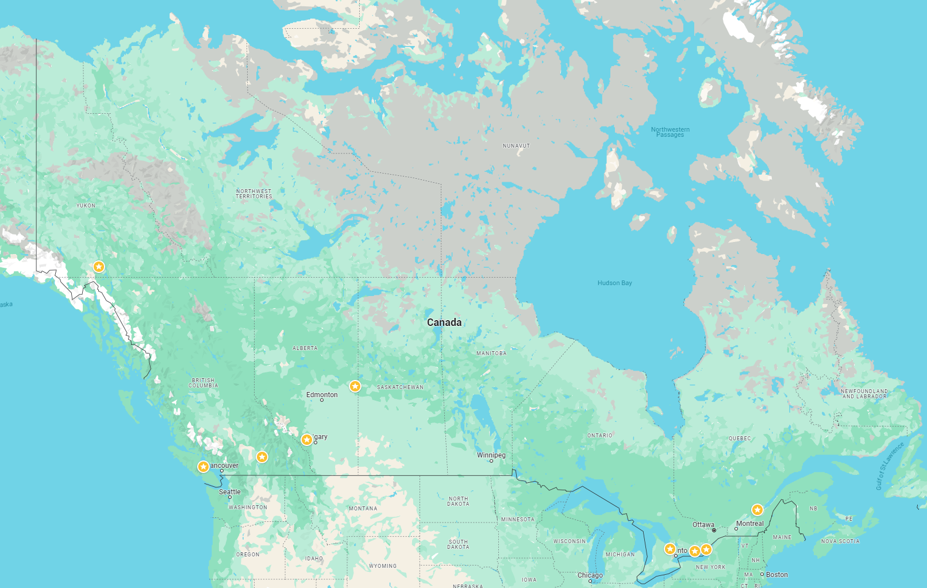
*limited number of out-of-region slots
Whitehorse CTC
Rocky
Mountain CTC*
Cold Lake CTC*
HMCS Ontario CTC*
Trenton CTC*
Valcartier CTC*
HMCS Quadra CTC
Vernon CTC
Blackdown CTC*

Slide 8
CTC Courses - All Elements
Course | Location | Duration
Introduction to Marksmanship (ITM) | Blackdown CTC, Valcartier CTC, Vernon CTC | 2 weeks
Air Rifle Marksmanship Instructor (ARMI) | Blackdown CTC, Rocky Mountain CTC, Valcartier CTC, Vernon CTC, Whitehorse CTC | 4 weeks
Introduction to Drill and Ceremonial (ITDC) | Blackdown CTC, Rocky Mountain CTC, Valcartier CTC, Vernon CTC | 2 weeks
Drill and Ceremonial Instructor Course (DCI) | Blackdown CTC, Rocky Mountain CTC, Whitehorse CTC, Valcartier CTC, Vernon CTC | 4 weeks
Introduction to Fitness and Sports (ITFS) | Blackdown CTC, Valcartier CTC, Vernon CTC | 2 weeks
Fitness and Sports Instructor Course (FSI) | Blackdown CTC, Valcartier CTC, Vernon CTC | 4 weeks
Introduction to Military Band (ITMB) | Blackdown CTC, HMCS Quadra CTC | 2 weeks
Military Band Musician (MB) | Blackdown CTC, HMCS Quadra CTC, Valcartier CTC | 4 weeks
Introduction to Pipe Band (ITPB | Blackdown CTC | 2 weeks
Pipe Band Musician (PB) | Blackdown CTC | 4 weeks

Slide 9
CTC Courses - Air Specific
Course | Location | Duration
Aviation Technology and Aerospace (ATA) | Blackdown CTC, Cold Lake CTC, HMCS Quadra CTC, Valcartier CTC | 2 weeks
Advanced Aviation Course (AA) | Blackdown CTC, Cold Lake CTC, HMCS Quadra CTC, Valcartier CTC | 4 weeks
Glider Pilot Training Course (GPTC) | Trenton CFTC | 6-7 weeks
Introduction to Survival (ITS) | Blackdown CTC, Cold Lake CTC, Valcartier CTC, Vernon CTC | 2 weeks
Survival Instructor Course (SI) | Blackdown CTC, Cold Lake CTC, Valcartier CTC, Whitehorse CTC | 4 weeks

Slide 10
Technology and Digital Learning Centre (TDLC) Courses
Course | Dates | Duration
Cyber Safety and Security Team Leader | 22 July - 2 August 2024 | 2 weeks
Support Services Team Leader | 8 - 19 July 2024 | 2 weeks
Small Craft Operator | 22 July - 2 August 2024 | 2 weeks
Basic Microdrone Operator | 5 - 16 August 2024 | 2 weeks
Nova Quest | 5 - 16 August 2024 | 2 weeks
Cadets attending the TDLC require:
Laptop/computer
Stable Internet connection
Webcam and microphone
Active Cadet365 account
Knowledge of Microsoft Teams

Slide 11
Pay Details per Rank
48 or 49 training days
Minimum working rank of Sergeant
Rank | Daily Rate
Flight Corporal | $96.00
Sergeant | $104.00
Flight Sergeant | $112.00
Warrant Officer 2nd Class | $120.00
Warrant Officer 1st Class | $128.00

Slide 12
How to Apply
Application via FORTRESS (deadline: March 18th)
Inform Lt Choi of the following:
Desired CTC Location
Desired Position Ranking:
Training (Flight Staff in a Training Company)
Support (Operations, Admin, Supply, Cadet Correspondent, Canteen)
Senior Cadet Selection (for WO2/WO1 positions)
Details on specialized knowledge training (music, drill, etc.)
Mail in items to RCSU (received NLT March 31st)
2024 Federal Tax Form (TD1-e)
2024 Provincial Tax Form (TD1BC-e)
One of:
VOID cheque from cadet’s bank in their name
Direct deposit form printed from cadet’s bank account online banking portal
Mail this NLT March 25th

Slide 13
Life at Camp
Pre-course training/evaluation
Position Assignment
Being a Staff Cadet

Slide 14
11 Mar 2024
655 Internal Staff Cadet Briefing
12&13 Mar 2024
RCSU-led Staff Cadet Webinars
Valuable information on Staff Cadet applications, life, and processes
16 Mar 2024
655 Internal Notification Deadline
Notify Lt Choi of intent to apply to Staff along with:
Desired CTC Location
Desired Position Ranking: Training, Support, Senior Cadet Selection (for WO2/WO1 positions)
Details on specialized knowledge training
25 Mar 2024
Mail in items to RCSU
Timeline
Tax forms and banking information Items must be received by RCSU NLT 31 Mar 24

Slide 15
Lt Choi:
655richmondtraining@gmail.com
RCSU Address:
ATTN: J1 CTC Staffing
Regional Cadet Support Unit (Pacific)
PO Box 17000 Stn Forces
Victoria BC V9A 7N2
Key Contact Information

Slide 16
Questions?

Slide 17
RCSU Informational Webinars
Tues 12 Mar 2024 1900hrs
https://teams.microsoft.com/l/meetup-join/19%3ameeting_ZDZhYjczYTktM2E1Zi00MGQ1LWIwYzQtN2VjYzE1ODczM2Ri%40thread.v2/0?context=%7b%22Tid%22%3a%22ab126afb-e60c-4e2f-b6cf-c7350c76dc84%22%2c%22Oid%22%3a%22d60fa0bf-d3c6-4dbe-9c50-de62127f6645%22%7d
Meeting ID: 286 872 715 912 Passcode: b6bgTL or call in (audio only) +1 647-794-5625,,857160933# Canada, Toronto Phone Conference ID: 857 160 933#
Wed 13 Mar 2024 1800hrs
https://teams.microsoft.com/l/meetup-join/19%3ameeting_NWI4NzBkYWQtMDE0My00OWNjLWExNzEtN2I4ZGY3ZmJmMWY3%40thread.v2/0?context=%7b%22Tid%22%3a%22ab126afb-e60c-4e2f-b6cf-c7350c76dc84%22%2c%22Oid%22%3a%22d60fa0bf-d3c6-4dbe-9c50-de62127f6645%22%7d
Meeting ID: 230 547 463 824 Passcode: KBB8xG Download Teams or call in (audio only) +1 647-794-5625,,343567148# Canada, Toronto Phone Conference ID: 343 567 148#

Slide 18
Resources
13-28 Annex D - Staff Cadet Prerequisites – Air Cadets - Canada.ca
13-28 – Advanced Training – Staff Cadets - Canada.ca
CANCDTGEN 001/24 - Canada.ca (Rate of Pay)
Cadet Summer Training 2024 - Canada.ca
Cadet Training Centre (CTC) Summer Courses 2024 - Canada.ca
Technology and Digital Learning Centre (TDLC) - Canada.ca

